Slide 1
Imbalanced Dataset

Slide 2
Base Algorithms
RF is robust to overfitting (thus solving one of the most significant disadvantages of the single decision tree).
Parameterization remains quite intuitive and straightforward.
There are many successful use cases where the random forest algorithm was used in highly unbalanced datasets as we propose for this project.
Random Forest
Will add later for Logistic Regression

Slide 3
Type A: Balanced Random Forest
Type B: Weighted Random Forest
Data Science Team
DA Team
Issue with a normal RF & an Imbalanced dataset: Significant probability that a bootstrap sample contains few or even none of the minority class, resulting in a tree with poor performance for predicting the minority class.
To overcome that the Data Science Team had implemented a special type of RF called “Balanced Random Forest”
Balanced Random Forest starts with Down sampling the majority class.
Balanced Random Forest combines the down sampling majority class technique and the ensemble learning idea, artificially altering the class distribution so that classes are represented equally in each tree
Disadvantage: Loss of information, as a large part of the majority class is not used.
Proposal for new type of Random Forest by DA team in Corp Audit for a Cost Sensitive learning approach
Weighted Random Forest puts more weights on the minority class, thus penalizing more heavily on misclassifying the minority class.
Disadvantage: WRF assigns a weight to the minority class, possibly making it more vulnerable to noise (mis-labeled class) than BRF
Disadvantage : BRF is computationally more efficient with large imbalanced data, since each tree only uses a small portion of the training set to grow, while WRF needs to use the entire training set.
A majority case that is mislabled as belonging to the minority class may have a larger effect on the prediction accuracy of the majority class in WRF than in BRF.
Both Methods improve minority prediction and between them there is no clear winner
Notes:
https://statistics.berkeley.edu/sites/default/files/tech-reports/666.pdf

Slide 4
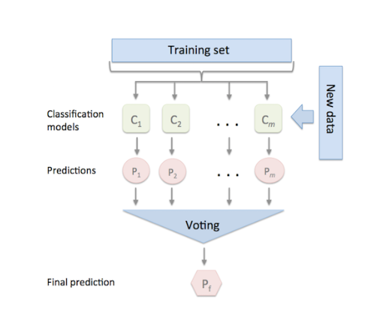
Proposal for Ensemble Methods(LR, RF) with SVM(Meta Classifier)
Reasons for Ensemble
Random Forest
Logistic Regression
Average the models prediction making it robust
Prevents overfitting
Improves Performance
SVM
Notes:
couple of reasons for choosing RF in this project:

Slide 5

Existing Framework for Random Forest
4 Class Ordinal Hierarchy
Triggering Events
Rule Breaking (AML criteria)
Money Order
Other (NANP not matching AML criteria)
Most Suspicious
2nd most Suspicious
Source
Database
CETR→ Money Orders (92000 records)
NANP -→Loan Repay, non premium , surrenders , withdrawals , free looks (1.5 mil records)
Teradata-→ D/W →Policy Owner, policy , Insured) (14 mil records)
ARCHER
History
20,000 CASES
637 SARS
3rd most Suspicious
Least Suspicious
CETR(96%)
NANP(4%)
SARS FILING SOURCE
Detection OF 4% NANP difficult
Solution to detect NANP
Notes:
Archer = Name of database to store AML related entity , transactions and policies.
Rule breaking (>$5000 k etc) type of transactions enter Archer , Compliance team reviews and files SARS if necesssary

Slide 6
FEATURE SELECTION
More Data and More Relevant Features
Assuming that there are relationships in the data then giving the model more data will allow it to better understand how to map a set of features to a label.
Feature Importance:
Use Python’s inbuilt functions skleanr’s SelectfromModel and get_support to select all the features which are more important than the mean importance of all the features by default. We can alter this threshold if we want.
Correla
Correlation Plots
Finding correlations between the variable and our target
Notes:
https://towardsdatascience.com/improving-random-forest-in-python-part-1-893916666cd

Slide 7
Approach to handle imbalance
Stratified Cross-Validation (CV)-→ In each CV, the model also predicts (probabilities, not the class) the test data. At the end of the cross-validation, we have five testing prediction probabilities.
Finally, we average the prediction probabilities for all classes.
While splitting data we will ensure consistent class distribution between training and test sets through stratification.
Set Class Weight/Importance-→ Impose a cost penalty on the minority class misclassification to reduce bias towards majority class.
We will assign a high weight to the minority class (i.e., higher misclassification cost). The class weights are then incorporated into the RF algorithm. We determine a class weight from the ratio of observations in different classes.{Grid Search in sklearn Python}
Over-Predict a Label than Under-Predict:-→ We force the model to over predict the minority class.
Penalize the model most if it misclassified minority class, a little less for majority class.
To implement the method, we will change the probability threshold for each class.

Slide 8
Approach for Fine tuning Classifier
Hyper Parameter Tuning
Adjust probability threshold to increase performance of minority class
Will choose the best hyper parameters and keep the classifier with the highest recall score.
Will use Grid Search package in Python
Will set scoring method = recall it’s the most desirable metric for fraud detection to get less false negatives
Will fit several random forests based on combinations in param grid(number of trees, features, depth etc) and select those parameter values that yield maximum recall score.
Refit those parameters into the full training set and use it to make predictions
Create an array of class probabilities lets say y_scores
Generate precision-recall curve for the classifier
Create a function that will take an input of probability threshold “t” from us and return y_scores I,e class probability]
Create another function to return precision and recall with respect to the threshold value t mentioned in Step3
Use grid Search iterate by changing t value till we reduce false negatives.
View the trade off between precision and recall by plotting them together as a function of the decision threshold. We may need to select an operating point that allows for some false positive rate > 0.0.
Notes:
Grid-searching can be applied across machine learning to calculate the best parameters to use for any given model.
Grid search is an approach to parameter tuning that will methodically build and evaluate a model for each combination of algorithm parameters specified in a grid.

Slide 9
Random Forest Implementation
1) Predict probabilities instead of actual prediction.
2) Set the class weight.
3) Get probability distribution of minor class.
4) From the ROC curve & probability distribution obtain probability thresholds for classes.
5) Use the threshold to over-predict labels than under-predict.
6)Rank it so it appears in top few rows
7)Evaluation Metric
Use the inverse of the class distribution
present in the training dataset. For example, the class distribution of the test dataset is a 1:100
ratio for the minority class to the majority class. The invert of this ratio could be used with 1 for the majority class and 100 for minority class.
predict_proba to get a list of probabilities which represent the likelihood that a sample falls under a given category.
Raise the threshold for class #1 and a higher level of ## evidence is needed to call it class 1 so it should ## decrease sensitivity and increase specificity
precision and recall, false positive rate and false negative rate, $F$-measure and weighted accuracy are computed.

Slide 10
Performance Improvement methods
Over Predict Minority Class
Class Weight Adjust
Technique-→ Penalize the model most if it misclassified minority class, and the least for majority class .
The splitting criterion can be updated to not only take the purity of the split into account, but also be weighted by the importance of each class.
Our intuition for cost-sensitive tree induction is to modify the weight of an instance proportional to the cost of misclassifying the class to which the instance belonged
To implement this we may plot Histogram of predicted probabilities
Small Weight: -→Less importance, lower impact on node purity-→ We will assign to majority class
Large Weight: -→More importance, higher impact on node purity-→ We will assign to minority fraud class so that will allow more examples from the majority class to be classified for the minority class,
We can change the probability threshold for minority & majority. A greater probability for minority and less for majority so that the model is forced to over predict class.
Final prediction of Random Forest → Aggregate the weighted vote from each individual tree where weights are average weights in terminal nodes.
We adopt a trial and error approach of setting weights dependent on the frequency of class values i.e inverse of the class distribution present and also use Grid Search to help in that direction.
Create functions to adjust classes and generate new class predictions based on the prob threshold we set.
To help us find the right figure for probability threshold we create a function that will plot precision recall curve for each prob value and iterate.

Slide 11
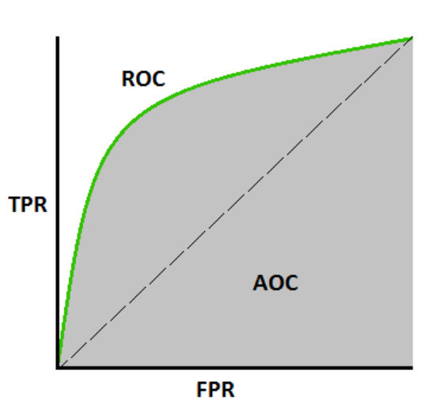
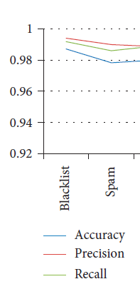
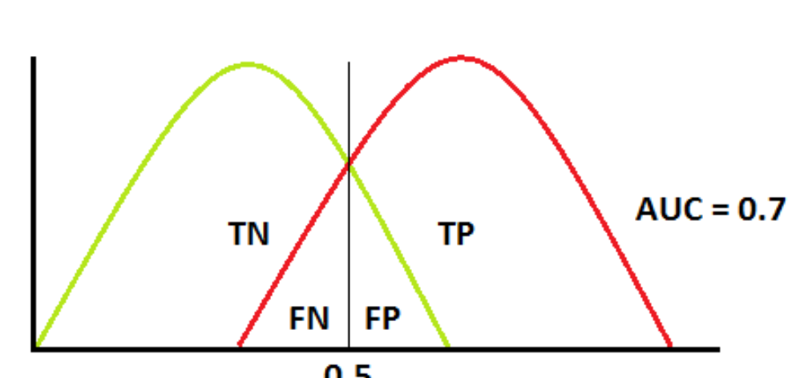
Evaluation metrics
ROC is a probability curve
Triggering
Rule Breaking
AUC --→→ tells how much model is capable of distinguishing between classes. Higher the AUC, better the model is at predicting 0s as 0s and 1s as 1s.

Slide 12
Set up the ensemble
Train the ensemble
Predict on new data
Train each of the L base algorithms on the training set.
Perform k-fold cross-validation on each of these learners and collect the cross-validated predicted values from each of the L algorithms.
The N cross-validated predicted values from each of the L algorithms can be combined to form a new N x L matrix. This matrix, along wtih the original response vector, is called the “level-one” data. (N = number of rows in the training set.)
Train the metalearning algorithm on the level-one data. The “ensemble model” consists of the L base learning models and the metalearning model, which can then be used to generate predictions on a test set.
To generate ensemble predictions, first generate predictions from the base learners.
Feed those predictions into the metalearner to generate the ensemble prediction.
Base Algo -→ RF, LR(with a specific set of model parameters).
Metalearning algorithm-→SVM

Slide 13
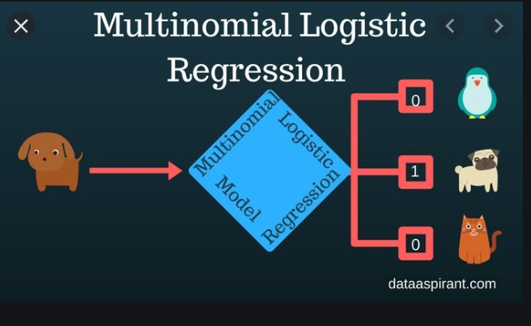
Multinomial Logistic Regression
Logistic Regression: Will use the techniques of Linear regression in the initial stages to calculate the logits (Score).
In the later stages uses the estimated logits to train a classification model. The trained classification model performs the multi-classification task.
Logistic regression models are categorized based on the number of target classes and uses the softmax function to predict the target class. Here we have multi class(Triggering , Rule breaking, Money Order, Other)
Calculated Logits (score) for the linear regression model will pass through the softmax function. The softmax function will return the probabilities for each target class. The high probability target class will be the predicted target class.

Slide 14
Simple Logistic Regression:
Will use the techniques of Linear regression in the initial stages to calculate the logits (Score).
In the later stages uses the estimated logits to train a classification model. The trained classification model performs the multi-classification task.
Logistic regression models are categorized based on the number of target classes and uses the softmax function to predict the target class. Here we have multi class(Triggering , Rule breaking, Money Order, Other)
Multinomial Logistic Regression STAGES
Inputs
Linear model
Logits
Features
Matrix A(features)= {x1, x2…x)
Matrix B (weights) ={W1, w2}
Linear model output -→ w1*x1, w2*x2, w3*x3
Scores that change with change in weights
Softmax Function
Cross Entropy
One-Hot-Encoding
Parameter Optimization
Calculate probability of given score
An iteration process where the calculated weights for each observation used to calculate the cost function which is also known as the Loss function
Similarity distance calc between
the probabilities calculated
from the softmax function & target (hot encoding)
Represent the target values
or categorical attributes into a binary representation
Notes:
https://dataaspirant.com/2017/03/14/multinomial-logistic-regression-model-works-machine-learning/

